Slide 1

Environmental, Safety & Security
Sequential Safety Meeting
August 2026
ANACORTES REFINERY

Slide 2

ESS Safety Metrics
ORIR: OSHA Recordable Injury
Anacortes
1 - Chipped Tooth
AFPM 1a: Actual Incident - serious injury that caused a fatality, hospitalization, or other life-altering event.
AFPM 1p: Potential Incident - an incident with the potential for fatality, hospitalization, or other life-altering event, including near misses.
Anacortes
PSE: Process Safety Event, refer to R-12-007
DEI: Designated Environmental Incident, refer to R-13-027
Notes:
AFPM 1a: actual incident - serious injury that caused a fatality, hospitalization, or other life-altering event.
AFPM 1p: potential incident - an incident with the potential for fatality, hospitalization, or other life-altering event, including near misses.
ORIR: OSHA Recordable Injury Rate = (number of recordables/(contractor + employee hours worked))
PSE: Process Safety Event, refer to R-12-007
DEI: Designated Environmental Incident, refer to R-13-027

Slide 3
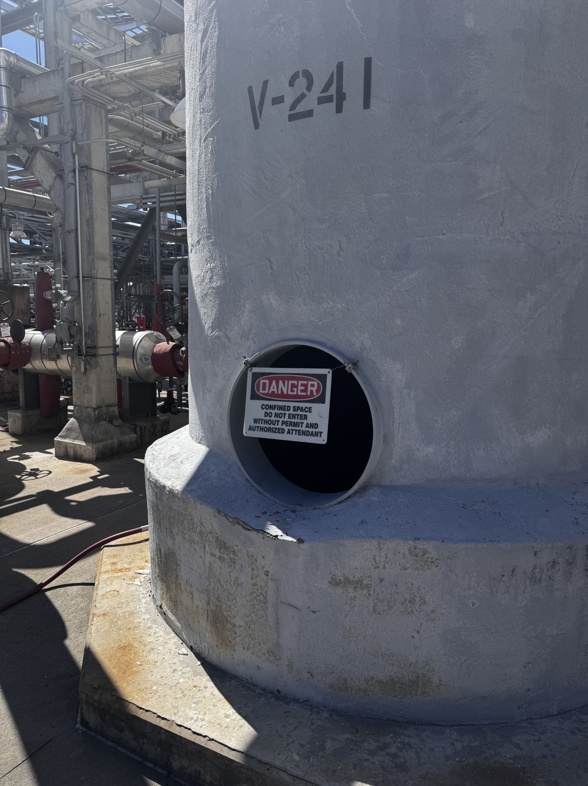
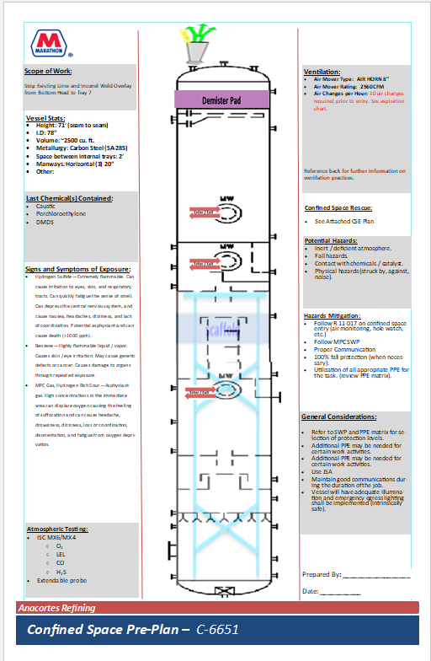
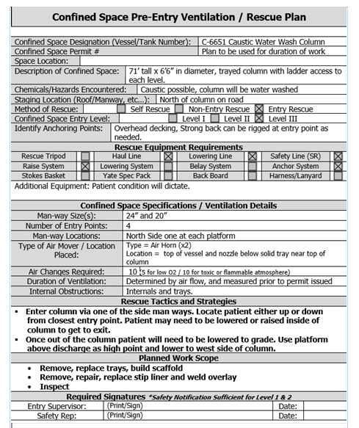
Start Safe and Stay Safe:
Confined Space Reference Sheet
Our site changed the document required for confined space entry during the 2025 TAR, however we continue to see the old format in circulation.
Before work in a confined space can begin, a Confined Space Reference Sheet must be provided in accordance with R-11-17.
This document contains vital information for a space to permit work.
A Rescue Plan is one part of the Reference Sheet but alone does not have sufficient information about a space to permit work.

Slide 4
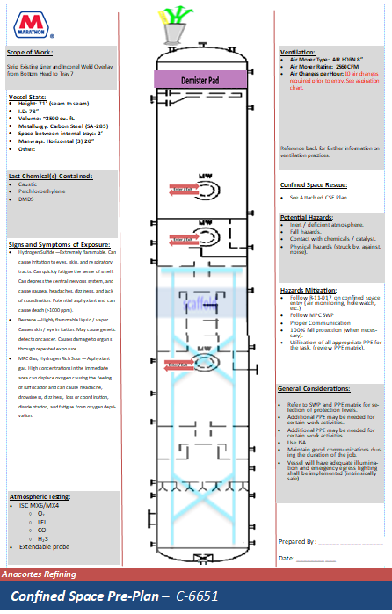
Start Safe and Stay Safe:
Confined Space Reference Sheet
Elements of a CSRS:
Scope of work: Outlines the expected work inside the confined space
Ventilation: Ventilation requirements specific to the space
Vessel Stats: Describes the interior workspace and entry ways
Last Chemical(s) Contained: Identifies potential chemicals that entrants may be exposed to
Potential Hazards: Identifies hazards that entrants may encounter
Signs and Symptoms of Exposures: Identifies what to watch for to indicate a potential exposure to hazardous materials.
Hazard Mitigations: Lists methods for mitigating potential hazards
General Considerations: Important safety considerations
Atmospheric Testing: Atmospheric testing requirements for CS
Space visualization: Provides visual layout of space with entry/egress points and ventilation points.

Slide 5
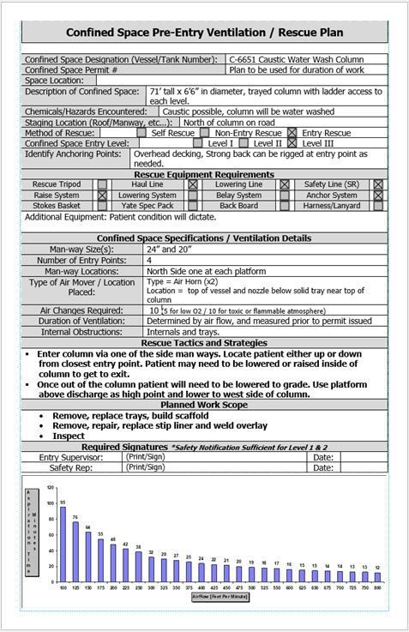
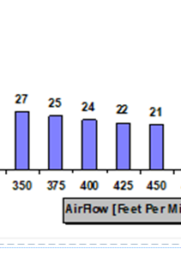
Start Safe and Stay Safe:
Confined Space Reference Sheet
The Rescue Plan is included on the back of the Reference Sheet and provides essential emergency guidance.
The Reference Sheet is generated during the planning phase. The Planner, Operations, and Safety coordinate to populate the information. Plans from previous projects or similar spaces must not be used.
A ventilation chart beneath the Rescue Plan specifies the minimum venting time based on airflow for that space. In the right example, an air flow of 400 FPM requires 24 minutes for 10 air changes.

Slide 6
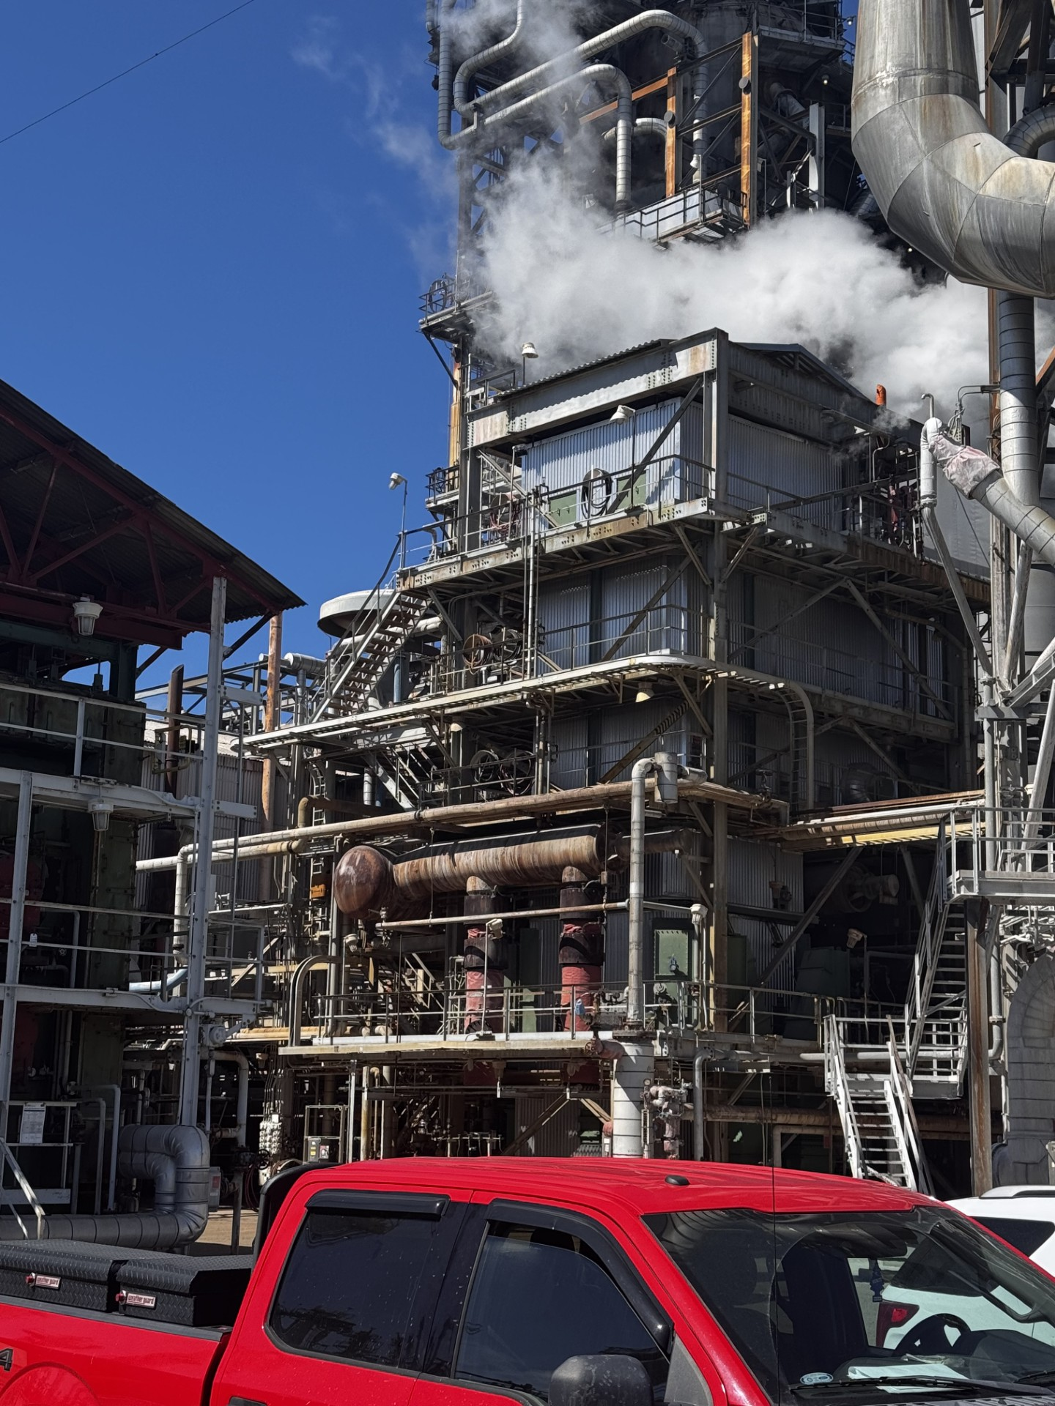
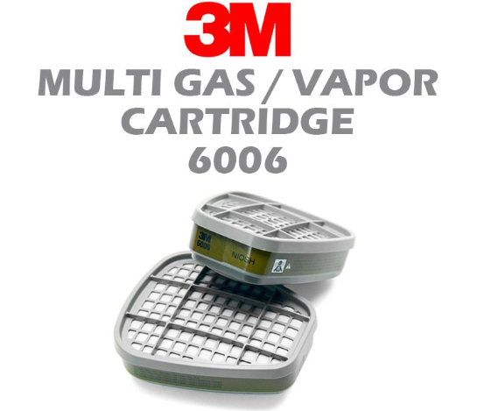
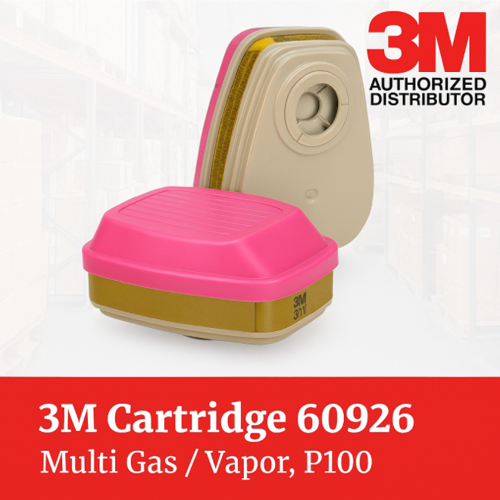
Start Safe and Stay Safe:
COB 1/2 Breathing Protection
EFFECTIVE 6/16
Due to measurable concerns of both SO2 and CO on Cob 1 and Cob 2 the following are required on first deck and above:
Full face APR with acid gas cartridges
AND 6-way or 4-way with personal SO2 meter
OR Supplied Air

Slide 7
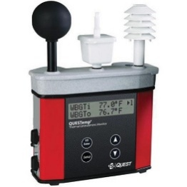
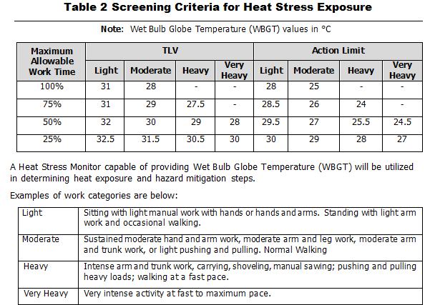
Start Safe and Stay Safe:
Heat Stress
How do we control the risk of occurrence of heat-related illnesses?
Safety will use this WBGT monitor to determine conditions
When ambient temperatures are high, Safety Department must evaluate conditions to determine if heat stress guidelines are necessary.
You should contact Safety if ambient temperatures in your work area reach what level?
95⁰F for Outdoor work
70⁰F for Confined Space work
If necessary, what are some recommendations that may be implemented to combat Heat Stress?
Work/rest regimen
Water consumption requirements
Cooling vest
Rotating personnel out of high heat areas
Taking breaks in shaded areas
See R-14-005 for more information on Heat Related Illness prevention

Slide 8
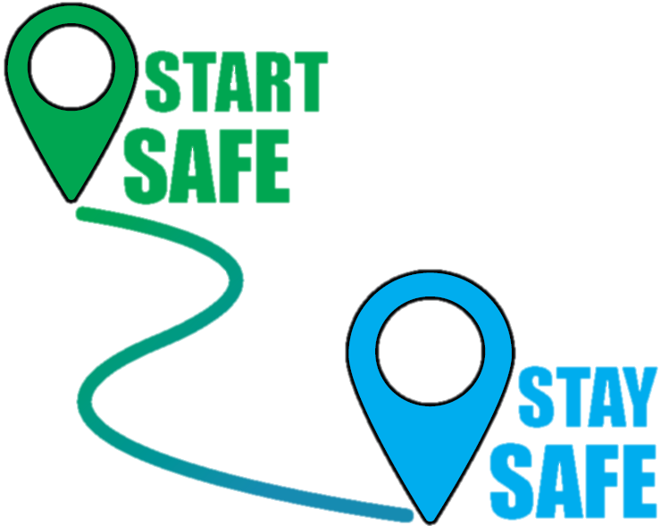
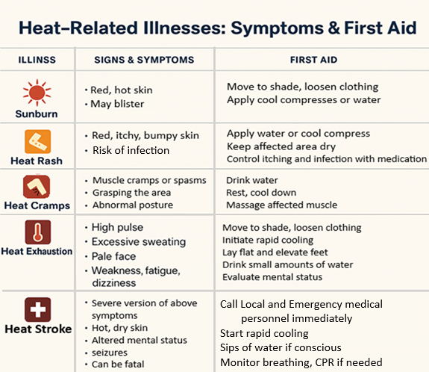
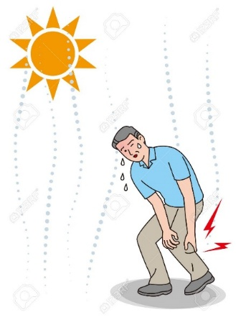

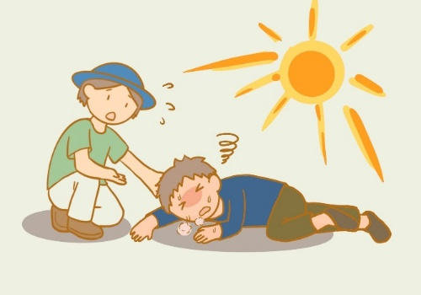
Start Safe and Stay Safe:
If you or a coworker shows signs of heat illness, stop work and contact medical personnel immediately
Notes:
Energy Isolation
Types of energies that need to be isolated include: electricity, thermal, pneumatic, chemical, mechanical, hydraulic, stored energy, etc.
Energy isolation to do maintenance
If there is potential for energy exposure, we need to isolate that energy before we can start work.
For example, if we need to conduct maintenance on a pump, we would need to:
Isolate the pump from the hazardous material inside by blocking the upstream and downstream valves, as well as any other auxiliary piping (removes the temperature, pressure, and chemical hazards).
Once blocked in, drain the contents of the pump to a safe location through bleed valves and verify the valves are holding.
The piping may need to be blinded to provide further protection, depending on the job.
De-energize the circuit breaker for the motor (this removes the electrical energy), and depending on the job, you may need to decouple the pump from the motor.
Then lock & tag out all isolation points to secure the equipment.
When energy isolation fails, the consequences can be catastrophic. SIF = Significant Injury and Fatality.
People can get electrocuted, burned, or exposed to toxic chemicals
A release of material can become a process safety incident, e.g., fires, explosions, and impacts beyond our facility fences
Energy isolation failure can be caused in various ways: missing an isolation point or not identifying all of the sources of energy; isolating the wrong system (e.g., isolated the wrong breaker due to mislabeling or incorrect diagrams); failing to verify energy isolation (e.g., bleed was plugged, didn't drain equipment all the way, or didn't ), isolation malfunction (e.g., valve starts to leak by, doesn't hold, etc.), isolation removed prematurely (e.g., miscommunication, failing to lockout/tagout adequately); wrong isolation type (e.g. using valve isolation and not blinding);
What type of work do you do that requires energy isolation?
Working on electrical equipment at home – have you ever had to shut down the breaker before you worked on out electrical outlet? That’s energy isolation.
Shutting down your car before you fill it up with gas – energy isolation
Unplugging appliances when you’re done using it – Kitchen Aid mixers, food processors, irons, etc., - leaving it plugged can be hazardous especially when you have small children
In some seismically prone areas (e.g., CA), an automatic gas shutoff is required at the inlet of your home gas line. That’s an automated isolation device to block gas during an earthquake.
When you close your pool for the winter, you isolate and drain your pool pump and piping it to ensure the water doesn’t freeze and break your equipment.

Slide 9
Incidents and Near Misses What’s the Difference
The criteria for reporting are the same.
The process for entering is different depending on if it is reported as a near miss or an incident.
See R-12-007 Near miss/Incident Reporting and Investigation Program
All events will be categorized as a CAT 0, 1, 2, 3, or 4 in accordance with RSP-1310 PSM/RMP Incident Investigation.
 | Near Miss | Incident
Definition | Any unplanned event or sequence of events, which could have, but did not result in adverse consequences. | Any unplanned event that negatively impacts or could have impacted Personal Safety, Environment, Process Safety, Product Quality, Security of an Asset.
Reporting | ALL employees can enter a near miss for review by the Area Team, supervisor or management for proper classification. | Entered by staff with a preliminary category of incident and is visible to entire company once submitted. To be reviewed by Area Team, supervisors, and management for proper classification and investigation lead.

Slide 10
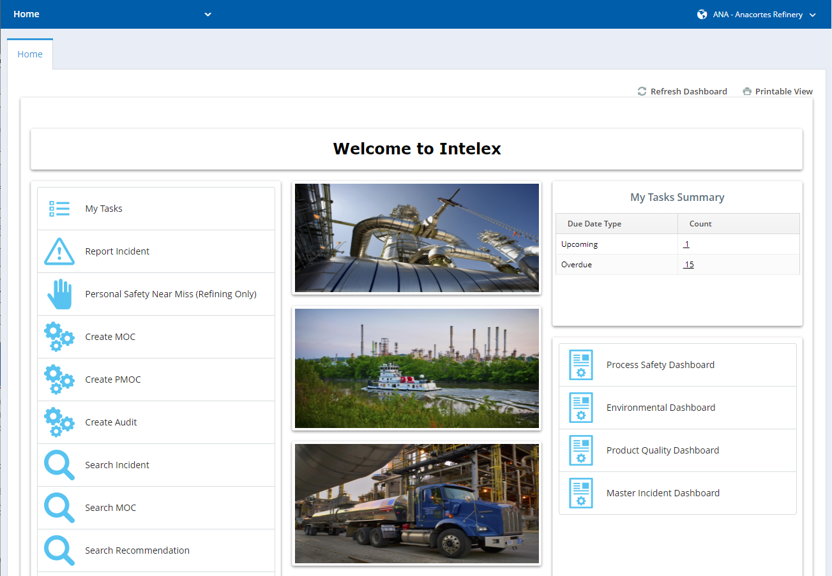
Intelex Home Page
Intelex Home Screen Details
My Tasks
  Summary of all items assigned to user
Report Incident (Staff)
  Process for submitting an incident (Process Safety, Environmental, Chemical Exposure, etc.)
Personal Safety Near Miss (All)
  Process for submitting a Near Miss
Search Incident
  Looking up past records
  Includes near misses
Notes:
  All users should read “Anacortes Refinery” at top right
  Screen display will vary by role

Slide 11
Site Examples of Near Misses that are Incidents
Incident Category | Safety | Health | Process Safety | Product Quality
RSP Definition | 1. Near Miss or First Aid that is not an AFPM matrix Tier 1P | Personal Alarm Monitor (PAM) false alarms (interference, cross sensitivity, dropped instrument) or alarm events which occur when proper respiratory protection is worn. | PSE T-3 | PQ-0
 | 2. Report Only Incident
 |  |  | PSE T-4 if management system failure
Site Example | A dropped object even though the area was barricaded and no one was injured. | Personal monitor went off but was due to cross interference with Hydrogen | Installing a sample station with no MOC even if it was not put into service. | Unplanned off-specification rundown streams that must be slopped.
  PQ-0* (Product Quality):
    Quality was not impacted, but there was a potential to have done so.
    A waiver is granted by Product Quality for product that failed specifications.
  PSE T-4* (Tier 4):
    A process safety Tier 4 event is a management system failure that did not result in a PSE 1, PSE 2, or PSE 3. Some examples of failures of process safety management systems are:
    A change occurred in a system without a Management of Change (MOC) or was placed into service without a Pre-Startup Safety Review (PSSR);
    A confined space error such as finding a process line connected to a confined space that has already been entered;
    A hot work error such as hot work conducted without a hot work permit or without required gas testing or without a fire watch;
    A line or equipment opening error such as opening the wrong equipment;
    Safety systems in bypass which are not being actively repaired or managed or do not have required management approvals.
    *Definitions in RSP 1503-050 and RSP 1070 Appendix R.
Question: Does anyone have an example of a Management System Failure?

Slide 12
Do You Know? Near Misses/Incidents Are the Same
Key Take Aways:
Near Miss Reporting is an avenue for all employees to report a potential incident
Read and understand our practices on what is expected to be reported. By reporting we build a culture for continuous improvement.

Slide 13
Bring It Up!!!
If there are Safety questions or concerns you wish to discuss, please bring them up!

