Slide 1
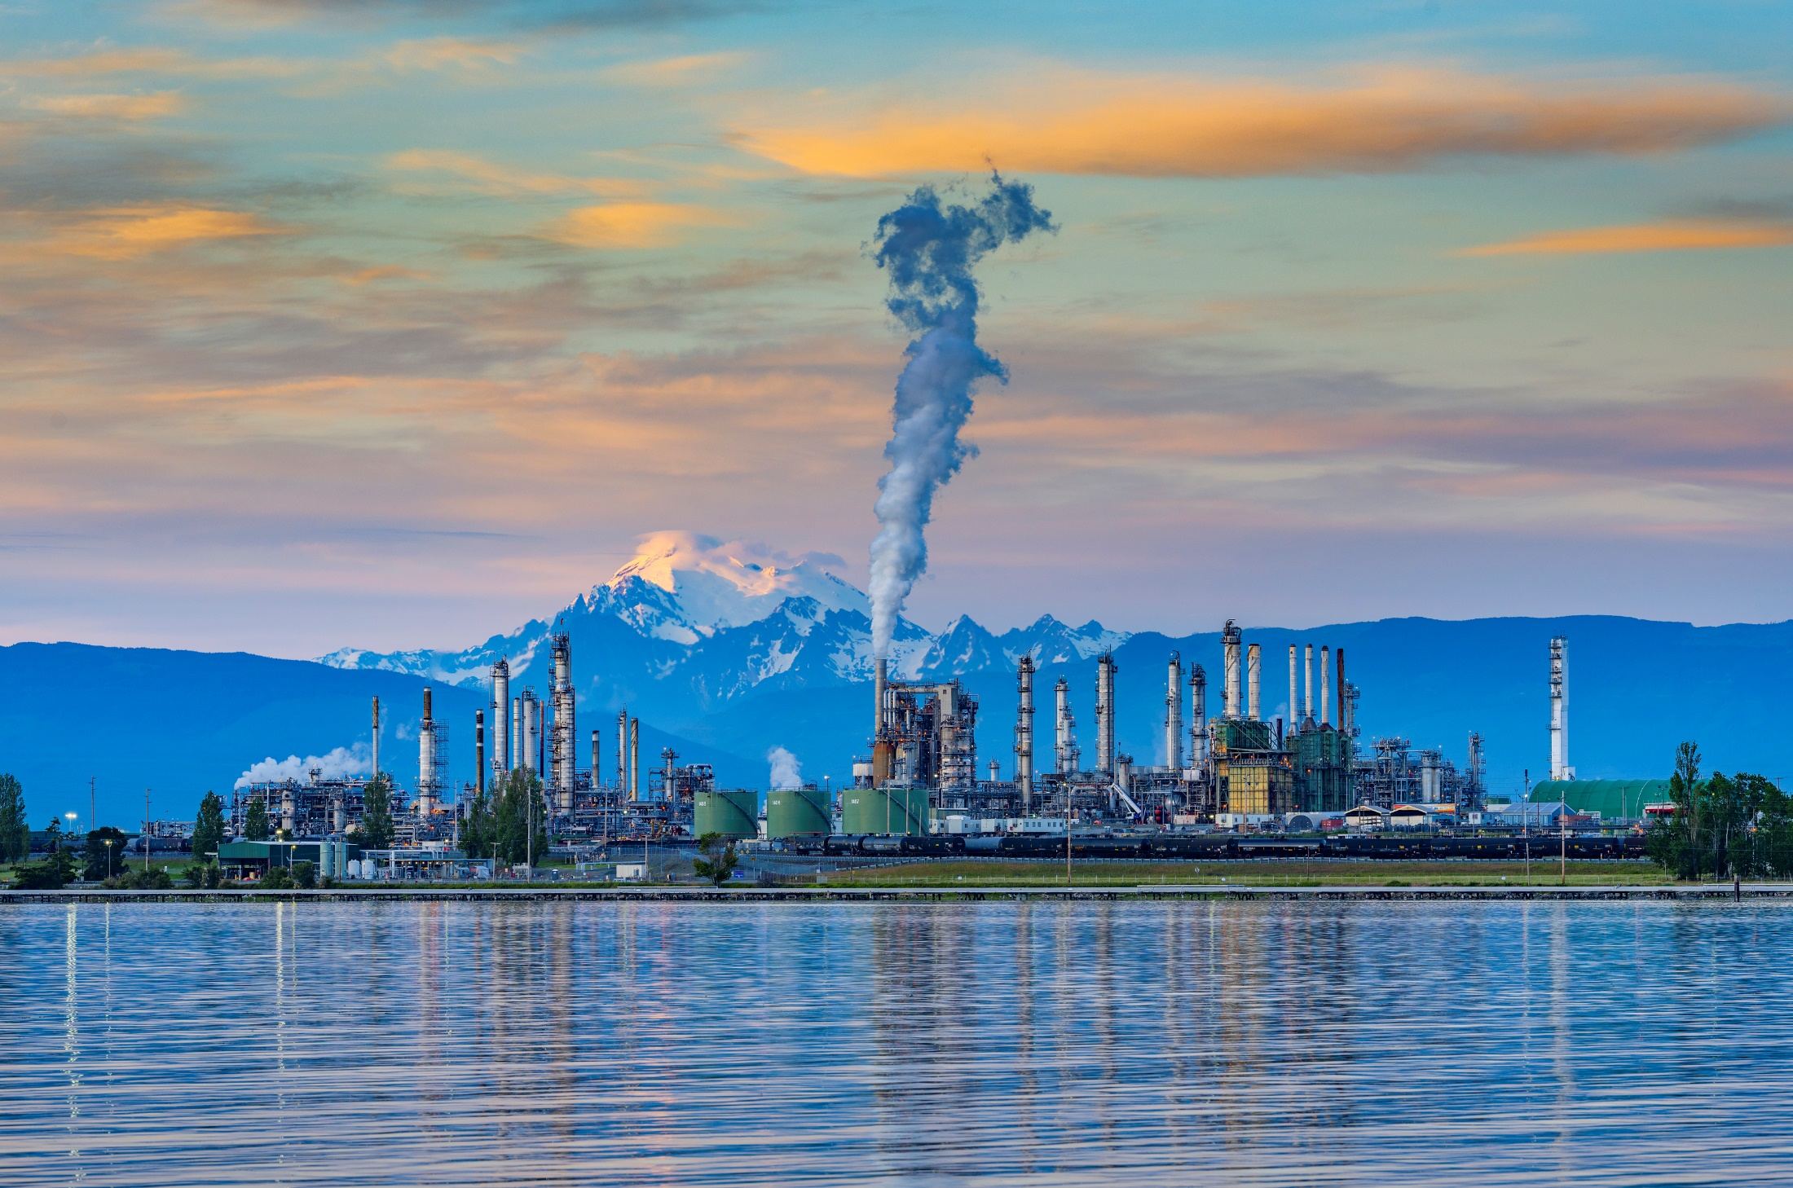

July 2025
Environmental, Safety & Security
Sequential Safety Meeting
ANACORTES REFINERY

Slide 2

ESS Safety Metrics
ORIR: OSHA Recordable Injury
Anacortes
1 – Debris in eye needing prescription eye drops
AFPM 1a: Actual Incident - serious injury that caused a fatality, hospitalization, or other life-altering event.
AFPM 1p: Potential Incident - an incident with the potential for fatality, hospitalization, or other life-altering event, including near misses.
Anacortes
1p - Fall Protection Not Utilized
1p - HVAC Electrical Spark
1p – GFCI Electrical Shock
1p – Grating/Handrail Removal Fall Hazard
1p – Energy Isolation Verification
PSE: Process Safety Event, refer to R-12-007
DEI: Designated Environmental Incident, refer to R-13-027
Notes:
AFPM 1a: actual incident - serious injury that caused a fatality, hospitalization, or other life-altering event.
AFPM 1p: potential incident - an incident with the potential for fatality, hospitalization, or other life-altering event, including near misses.
ORIR: OSHA Recordable Injury Rate = (number of recordables/(contractor + employee hours worked))
PSE: Process Safety Event, refer to R-12-007
DEI: Designated Environmental Incident, refer to R-13-027

Slide 3


Start Safe and Stay Safe:
Heat Stress Safety
As we move into summer months, it’s important to shift our focus to Heat Stress Awareness.
Working in high temperatures increases the risk of heat-related illness and injury.
Refineries amplify heat exposure with hot surfaces, heavy PPE, and limited airflow.
Awareness, prevention and quick action can prevent serious health impacts.
Average summer temperatures in Anacortes will reach mid to high 70’s ⁰F; temperatures in enclosed spaces can climb as high as 130⁰
Notes:
Energy Isolation
Types of energies that need to be isolated include: electricity, thermal, pneumatic, chemical, mechanical, hydraulic, stored energy, etc.
Energy isolation to do maintenance
If there is potential for energy exposure, we need to isolate that energy before we can start work.
For example, if we need to conduct maintenance on a pump, we would need to:
Isolate the pump from the hazardous material inside by blocking the upstream and downstream valves, as well as any other auxiliary piping (removes the temperature, pressure, and chemical hazards).
Once blocked in, drain the contents of the pump to a safe location through bleed valves and verify the valves are holding.
The piping may need to be blinded to provide further protection, depending on the job.
De-energize the circuit breaker for the motor (this removes the electrical energy), and depending on the job, you may need to decouple the pump from the motor.
Then lock & tag out all isolation points to secure the equipment.
When energy isolation fails, the consequences can be catastrophic. SIF = Significant Injury and Fatality.
People can get electrocuted, burned, or exposed to toxic chemicals
A release of material can become a process safety incident, e.g., fires, explosions, and impacts beyond our facility fences
Energy isolation failure can be caused in various ways: missing an isolation point or not identifying all of the sources of energy; isolating the wrong system (e.g., isolated the wrong breaker due to mislabeling or incorrect diagrams); failing to verify energy isolation (e.g., bleed was plugged, didn't drain equipment all the way, or didn't ), isolation malfunction (e.g., valve starts to leak by, doesn't hold, etc.), isolation removed prematurely (e.g., miscommunication, failing to lockout/tagout adequately); wrong isolation type (e.g. using valve isolation and not blinding);
What type of work do you do that requires energy isolation?
Working on electrical equipment at home – have you ever had to shut down the breaker before you worked on out electrical outlet? That’s energy isolation.
Shutting down your car before you fill it up with gas – energy isolation
Unplugging appliances when you’re done using it – Kitchen Aid mixers, food processors, irons, etc., - leaving it plugged can be hazardous especially when you have small children
In some seismically prone areas (e.g., CA), an automatic gas shutoff is required at the inlet of your home gas line. That’s an automated isolation device to block gas during an earthquake.
When you close your pool for the winter, you isolate and drain your pool pump and piping it to ensure the water doesn’t freeze and break your equipment.

Slide 4
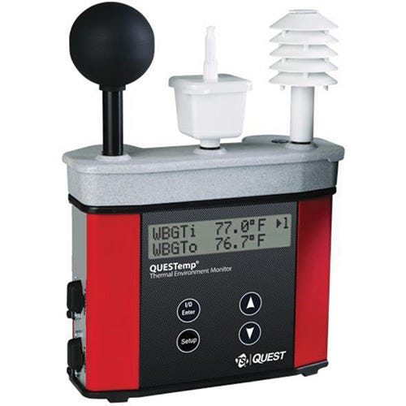
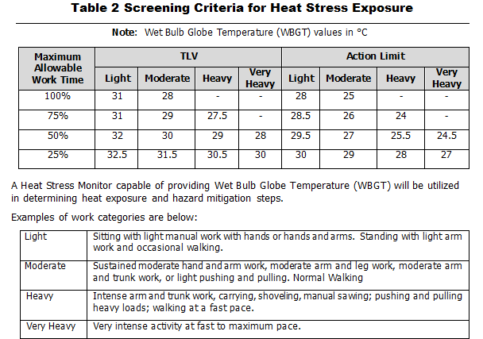
Start Safe and Stay Safe:
How do we control the risk of occurrence of heat-related illnesses?
Safety will use this WBGT monitor to determine conditions
When ambient temperatures are high, Safety Department must evaluate conditions to determine if heat stress guidelines are necessary.
You should contact Safety if ambient temperatures in your work area reach what level?
95⁰F for Outdoor work*
70⁰F for Confined Space work*
If necessary, what are some recommendations that may be implemented to combat Heat Stress?
Work/rest regimen
Water consumption requirements
Cooling vest
Rotating personnel out of high heat areas
Taking breaks in shaded areas
*Please be aware that these are working temperatures, not temperatures from the National Weather Channel.

Slide 5
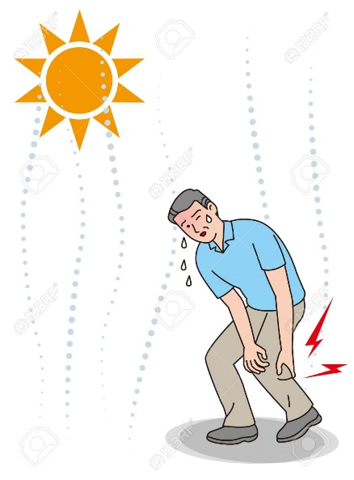
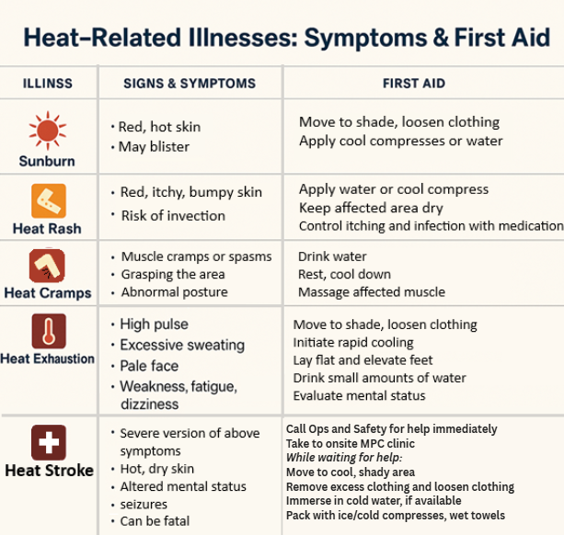

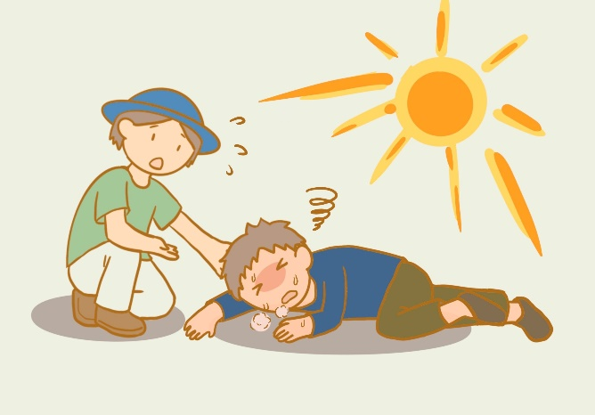
Start Safe and Stay Safe:
If you or a coworker shows signs of heat illness, stop work and contact medical personnel immediately
Notes:
Energy Isolation
Types of energies that need to be isolated include: electricity, thermal, pneumatic, chemical, mechanical, hydraulic, stored energy, etc.
Energy isolation to do maintenance
If there is potential for energy exposure, we need to isolate that energy before we can start work.
For example, if we need to conduct maintenance on a pump, we would need to:
Isolate the pump from the hazardous material inside by blocking the upstream and downstream valves, as well as any other auxiliary piping (removes the temperature, pressure, and chemical hazards).
Once blocked in, drain the contents of the pump to a safe location through bleed valves and verify the valves are holding.
The piping may need to be blinded to provide further protection, depending on the job.
De-energize the circuit breaker for the motor (this removes the electrical energy), and depending on the job, you may need to decouple the pump from the motor.
Then lock & tag out all isolation points to secure the equipment.
When energy isolation fails, the consequences can be catastrophic. SIF = Significant Injury and Fatality.
People can get electrocuted, burned, or exposed to toxic chemicals
A release of material can become a process safety incident, e.g., fires, explosions, and impacts beyond our facility fences
Energy isolation failure can be caused in various ways: missing an isolation point or not identifying all of the sources of energy; isolating the wrong system (e.g., isolated the wrong breaker due to mislabeling or incorrect diagrams); failing to verify energy isolation (e.g., bleed was plugged, didn't drain equipment all the way, or didn't ), isolation malfunction (e.g., valve starts to leak by, doesn't hold, etc.), isolation removed prematurely (e.g., miscommunication, failing to lockout/tagout adequately); wrong isolation type (e.g. using valve isolation and not blinding);
What type of work do you do that requires energy isolation?
Working on electrical equipment at home – have you ever had to shut down the breaker before you worked on out electrical outlet? That’s energy isolation.
Shutting down your car before you fill it up with gas – energy isolation
Unplugging appliances when you’re done using it – Kitchen Aid mixers, food processors, irons, etc., - leaving it plugged can be hazardous especially when you have small children
In some seismically prone areas (e.g., CA), an automatic gas shutoff is required at the inlet of your home gas line. That’s an automated isolation device to block gas during an earthquake.
When you close your pool for the winter, you isolate and drain your pool pump and piping it to ensure the water doesn’t freeze and break your equipment.

Slide 6

Start Safe and Stay Safe:
True or False?
Incident in South Texas (not MPC)
When working in high temperature environments, PPE requirements should be relaxed, such as rolling up sleeves on FR clothing, to help mitigate the effects of heat stress.
An employee suffered second-degree burns to the forearms and neck during a routine hot work task. The employee was wearing FR clothing compliant with NFPA 2112.
There was concern that the FR clothing may have failed during the flash fire, leading to injury despite the use of PPE.
A joint investigation was conducted and the safety team discovered:
-The employee had sleeves rolled up, leaving forearms exposed
-The shirt was unbuttoned at the collar, exposing the neck area
-undergarments worn were non-FR synthetic, which melted and contributed to skin injuries.
The safety team determined the injuries were not due to fabric failure, but improper wear and use of PPE
FALSE!
RSP -1162-000
Even the best PPE cannot protect if not worn properly

Slide 7
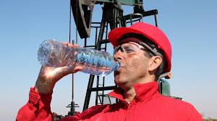
Start Safe and Stay Safe:
Lets talk Heat Stress
How do you personally stay cool and hydrated during hot shifts?
What does your team do well to mitigate heat stress? What can be improved?
What are some tasks that get riskier in high heat environments? How can we make these tasks safer?
What is the proper way to wear FR clothing?
Safety intention is accident prevention
Tucked in, sleeves down, free from holes/tears
Controlled Document R-14-005 covers our heat related illness prevention plan

Slide 8
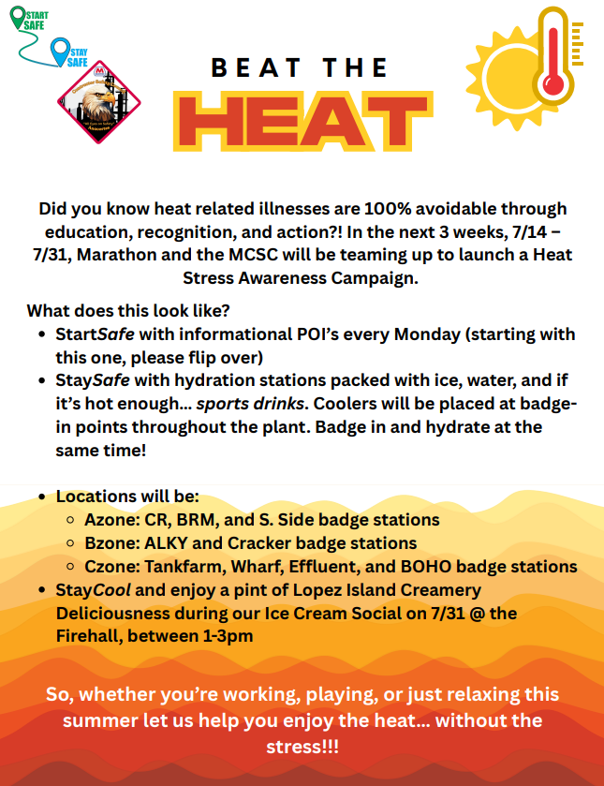
Upcoming from the Marathon Contractor Safety Council!

Slide 9
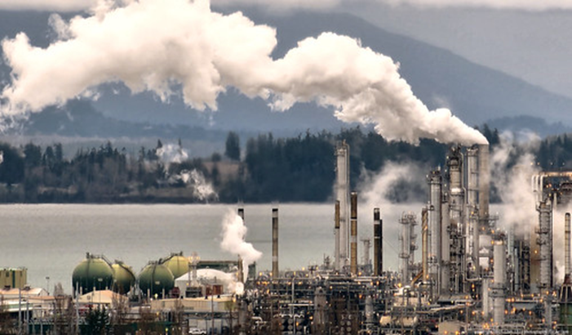
Enironmental
YTD permit deviations: 21
YTD DEI 1/2: 24
YTD DEI 3/4: 1
The Tier 4 DEI in the previous slide was for COB 2 ammonia excess emissions because the total emissions were greater than 5% of the limit for the semi-annual reporting period.
Background: ammonia limit was recently added to refinery air permit and recent stack test results did not agree with COB 2 SNCR engineering tests.
Most of the excess emissions occurred when COB 1 was down for maintenance; new limits have been established for periods when only COB 2 is running.
Excess ammonia emissions totaled 860 lbs, however the SNCR project has reduced NOx emissions from the Flue Gas Scrubber from about 800 tons to under 500 tons annually.

Slide 10
Environmental
YTD permit deviations: 21
YTD DEI 1/2: 24
YTD DEI 3/4: 1
Pressure Relief Devices
What to do when there is a lift that releases to atmosphere?
•Notify environmental, or enter an Intelex incident as soon as practical
•Environmental will evaluate if follow-up monitoring is required
•Only PRDs in organic HAP or gas/vapor service require follow up
•If follow up is needed:
•Insight environmental will monitor to ensure valve has reseated properly and returned to a state of no detectable emissions within 5 days of lift event
•Operations and Tech Service will need to provide information on root cause, duration of lift, amount of organic HAP released, and corrective action.

Slide 11
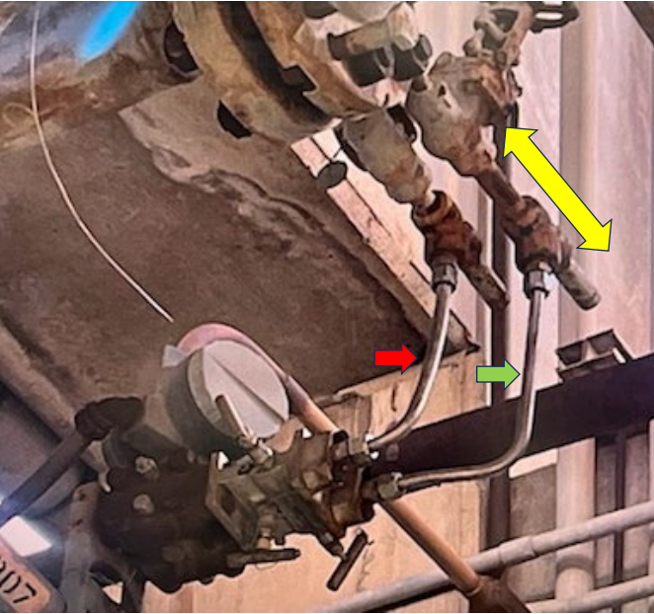
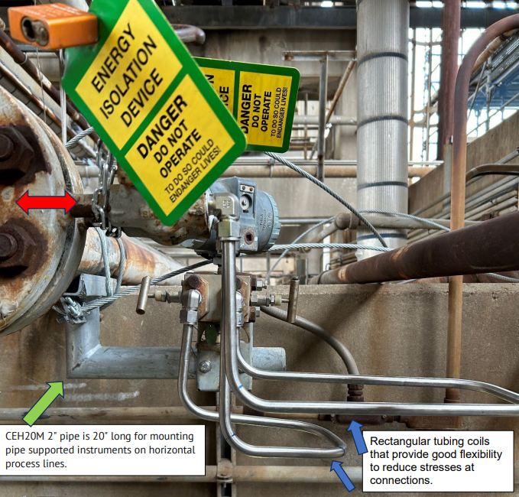
PSE1 MPC Process safety advisory
Galveston Bay refinery Transmitter tubing failure INC# 419885
PSA 25-05
Published 6/4/2025
On March 4, 2024, at the Distillate Desulfurization Unit, the tubing on a Kerosene charge pump minimum flow transmitter failed as a result of intermittent vibration and fatigue. This was the second tubing failure on this transmitter in the past 5 months, and the investigation recommendations from the initial failure had not been completed. After the second failure, the minimum flow transmitter legs were isolated and taken out of service until the incident investigation and recommendations were complete.
This incident was categorized as a PSE1 due to a release of 27 barrels of Kerosene.
  Causal Factors:
  Vibration of the minimum flow line occurs intermittently during operation.
  The tubing configuration installed after the previous failure was not as flexible as the original installation, increasing the loading on the tubing.
  During the assembly of the tubing after the previous failure, the compression nut was over-torqued, causing the back ferrule to dig into the tubing and creating a sharp stress concentration notch that weakened the tubing connection.
Transmitter installation prior to 2nd failure
Transmitter installation following final repair
Figure 1: The yellow double arrow shows the direction of vibrational movement based on the fatigue crack origins from the tubing on the left (red arrow).
Tubing expansion loops that provide good flexibility to reduce stresses at connections.

Slide 12

“THE REST OF THE STORY”:
A previous failure of tubing at the same transmitter occurred on October 15, 2023. Recommendations were made following the investigation to evaluate the minimum flow loop design to reduce vibration and add support to the transmitter. Before the recommendations were implemented, the second failure of the tubing occurred. Metallurgical analysis revealed that a stress concentration was created during installation of the short, inflexible section of tubing to the transmitter. This stress concentration became a weak point in the tubing, susceptible to vibration induced fatigue failure. Following the second failure, the transmitter was isolated and removed from service until proper support and tubing configuration were installed. The vibration in the piping system is the result of an incorrectly designed minimum flow control valve operating at < 5% output.
Tubing Bulletin issued in December 2023 references previous events. It is located here.
DISCUSSION TOPICS:
Operations/Engineering:
Over time, original equipment design may be impacted by changing process conditions. It’s important to recognize when equipment no longer meets our needs. In this example, a control valve should not operate continuously on the upper or lower output range, particularly if cavitation or vibration is present.
  If there are piping circuits with known vibration, engage your Maintenance/Engineering group when these cases are identified.
All Groups:
Discuss tubing installation best practices, including support and configuration. Reference SP-75-01 Instrument Piping Design and Material and RSD-70-XX Instrumentation Installation standard drawings.
A new IG-84 Piping Vibration Special Emphasis Program is being rolled out to complete piping/tubing vibration surveys at all sites over the next few years.
Tubing installation training courses are available in Workday or check with your local L&D for site-specific offerings.
Online: DC_REF_TUBING_INSTALLATION_INSPECTION
Instructor-led: BC_REF_MNT_110
GBR: GBR MT - Excellence in Maintenance & Reliability Microlearning Series: Tubing Installation
Global Action
Recommendations | Assigned to: | Due Date:
Review this advisory with your leadership team, and cascade to your entire organization to ensure site-wide review to improve process safety hazard recognition. | Division Managers | 8/31/2025
Update tubing installation guidelines in SP-75-01 Instrument Piping Design and Material for new construction activities. | Ryan Rojas | 6/30/2026
Create a new SP-M for modification, repairs and inspection of existing tubing installations. | Ryan Rojas | 6/30/2026
Update training material for tubing installation SP. | Steven Kidwell | 11/30/2026

Slide 13
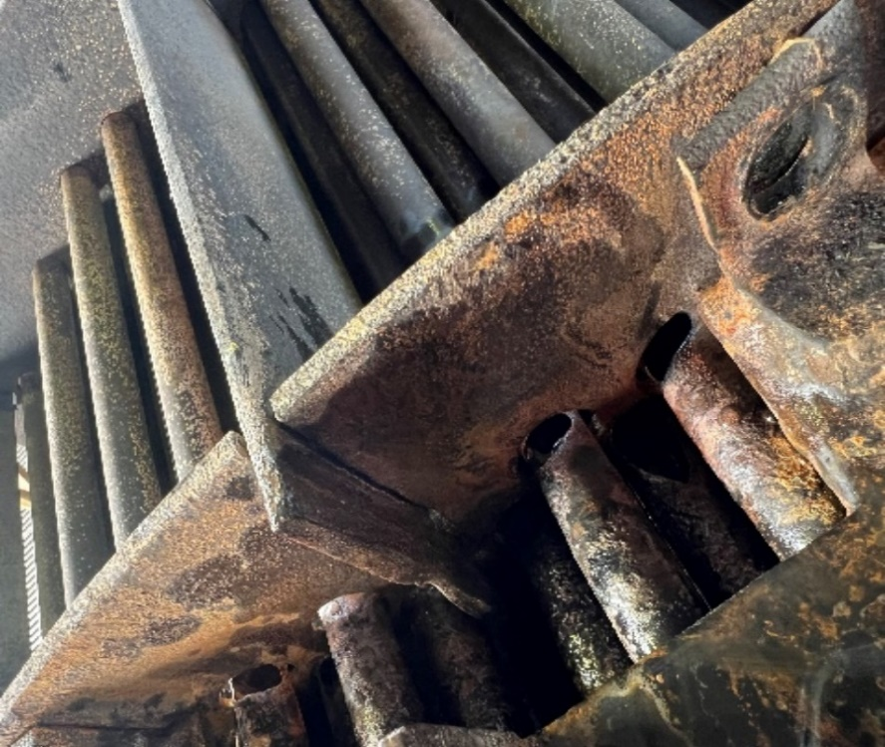
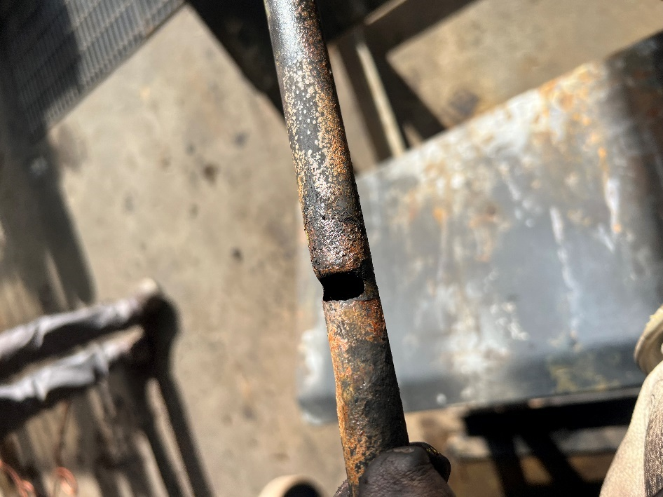
PSE1 MPC Post event learning report
ANACORTES HYDROCARBON LEAK TO Cooling Water Tower INC # 432815
Published 6/18/25
  On June 15, 2024, Operations was notified of a hydrocarbon leak into the Cooling Water Return at Cooling Water Tower #2. Operations began checking the cooling water systems in both the Fluidized Catalytic Cracking (FCC) and Alky units to identify the leak source. The cooling water returns from the Wet Gas Compressor interstage coolers (E-401 A/B) showed discoloration, indicating the presence of H₂S, which was identified as the source. The Wet Gas Compressor was shut down to complete repairs to both exchangers.
  This incident was categorized as a PSE1 due to release of flammable material.
  Causal Factors:
High levels of SO₃ gases in the FCC Reactor & Regenerator (R&R) section were carried downstream to the Gas Recovery Unit (GRU) during transient operations associated with unit restarts.
SO₃ undercarry from the regenerator during low-temperature continuous catalyst circulation was absorbed by the wash water, which is normally injected upstream of the inlets to the E-401 A/B interstage coolers. This H₂O/SO₃ mixture formed H₂SO₄, and the highly acidic mixture (~3 pH) caused rapid corrosion and erosion of the exchanger tubes, leading to through-wall failures of numerous tubes.
E-401A Tube extracted from exchanger skeleton

Slide 14


“THE REST OF THE STORY” During an abnormal standby operation to restart the FCC from a unit upset and shutdown, significantly higher levels of SO₃ gases than previously understood were carried under from the Reactor & Regenerator (R&R) section. This was caused by low operating temperature in regenerator bed (~1000 F) and continuous circulation while heating FCC catalyst with torch oil for ~14 days. These gases were continuously routed to the #1 Main Fractionator overhead stream and #1 Overhead Accumulator, which then became suction to the 1st stage of the Wet Gas Compressor. This SO₃-rich gas stream was then blended with wash water (normally used to remove ammonia byproducts) and injected upstream of the inlets to the E401 A/B interstage coolers. The resulting H₂O/SO₃ mixture formed highly acidic mixture, H₂SO₄ , which rapidly corroded the exchanger tubes, leading to through-wall failure of numerous tubes. Due to the higher operating pressure of the process stream compared to the cooling water return pressure to the Cooling Water Tower (CWT), LPG-range hydrocarbons backflowed into the cooling water return. This was routed to CWT #2 and out to the atmosphere via the riser vents.
Operations
Maintenance
Inspection
Engineering
DISCUSSION TOPICS:
Do we have any similar equipment/process/installation at our site?
For process units operating in abnormal conditions, are there local procedures or standards that provide guidance?
Discuss hazards that need to be recognized when operating in abnormal conditions in your unit.
Do unit PHAs review the hazards of transient or abnormal operation?
Review previous PSA with a hydrocarbon leak to Cooling Towers: PSA 16-18 Detroit GOHT REAC and Trim Cooler Failure.
Review what actions should be taken to identify and monitor hydrocarbon leakage into Cooling Towers.
  Does your site have an established protocol or procedure?
Recommendation from Site Investigation | Assigned to: | Due Date:
FCC Technologist update/create guidelines for SO₃ formation mitigation during transient operations in FCC Startup and Standby Operation RRDs and review with FCC Operations Advisory Group. | Tiffany Clark – assigned as part of ANA Investigation Recommendation No. 352969 | 4/1/2025

Slide 15
Bring It Up!!!
If there are Safety questions or concerns you wish to discuss, please bring them up!

